Slide 1
Converting CSV Files to Excel
This presentation will aid and assist you in converting a downloaded CSV file from the website www.mylegion.org to a data file in Microsoft Excel.
It is assumed that you already have the current password for your applicable username access level, and Microsoft Excel software on your computer.
Usernames can vary from the Post level to District level.
If you have any questions, comments or constructive feedback, fell free to contact a person from the training committee.

Slide 2
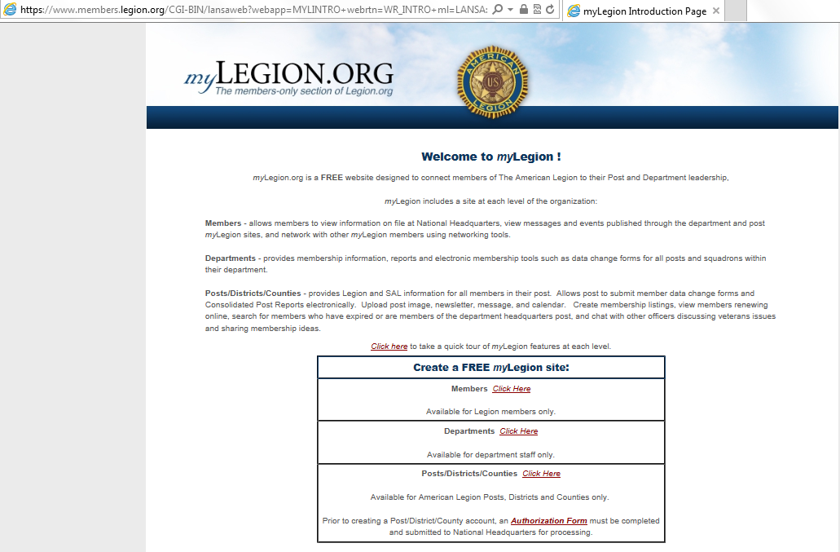
Selecting your organization level entry
From the main web site page, select your applicable area of reports you will be using.
In this example we will do a local Post report.
Mouse over the “Click Here” area and left mouse click.

Slide 3
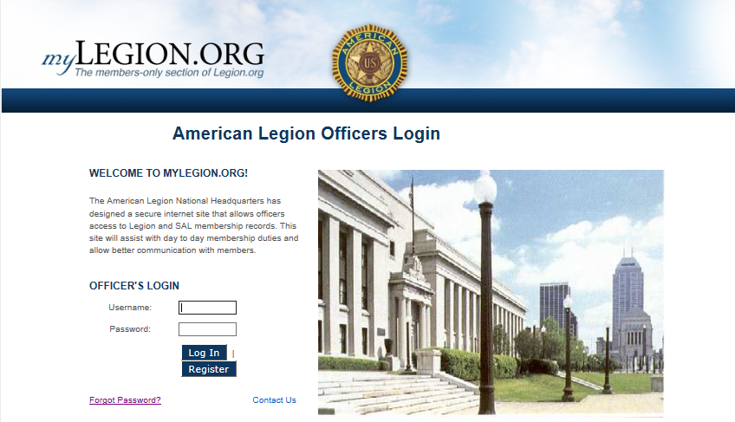
Logging in to your Post data.
Enter your Post username information.
i.e. LTX00##ADJ
Enter you post password. Passwords are required to change every 6 months, so make sure you have that information available to pass on to other Post officers when required.
Mouse over the “Clog In” area and left mouse click.

Slide 4
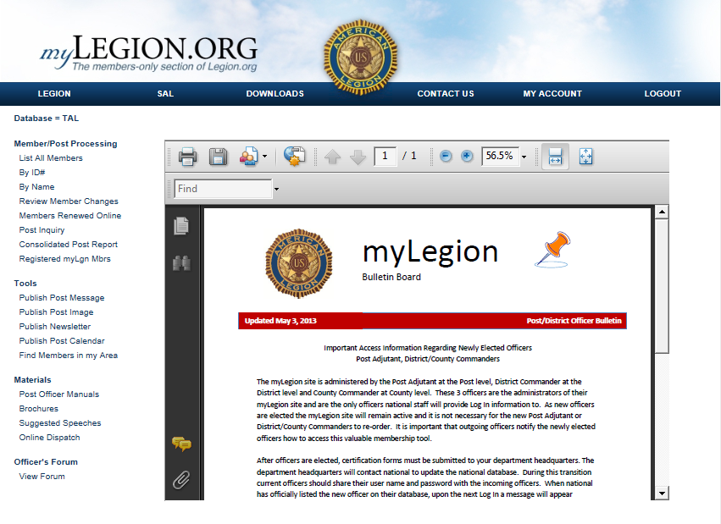
Pulling a Post 345 report.
Mouse over the “Find Members in my Area” and left mouse click.

Slide 5
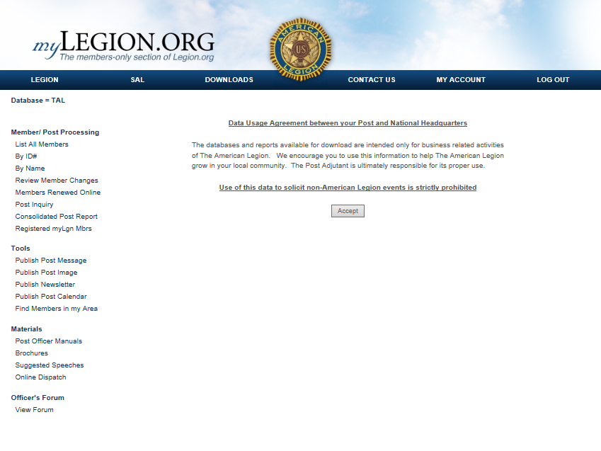
Data usage agreement.
Mouse over the “Accept” and left mouse click.

Slide 6
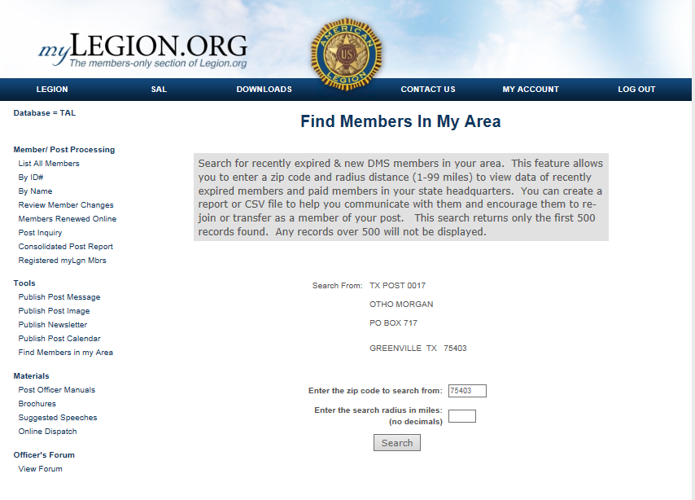
Finding members within your Post area.
Populate the zip code you would like your report to center from.
Populate the number of miles you would like the report to generate.
Mouse over the “Search” and left mouse click.

Slide 7
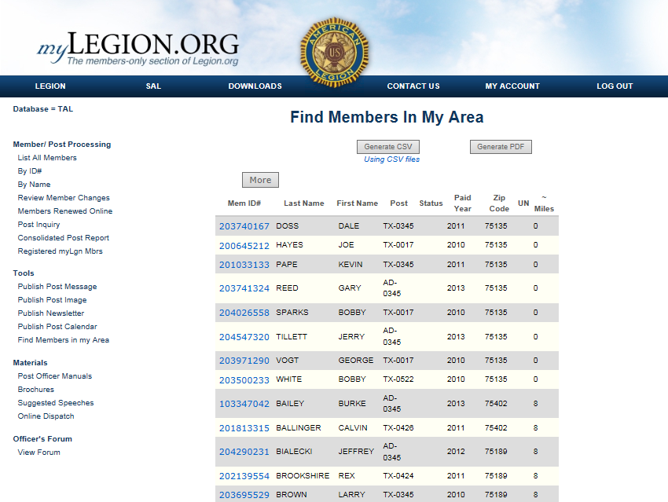
Generating the CSV file.
Mouse over the “Generate CSV” and left mouse click.
Give the program sufficient time to develop the data and download it to your computer.

Slide 8
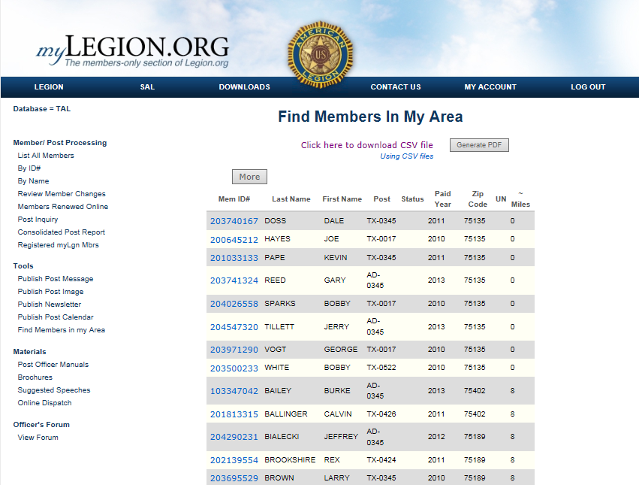
Downloading CSV Files to Excel
Mouse over the “Click here to download CSV file” and left mouse click.
Give the program sufficient time to develop the data and download it to your computer.

Slide 9
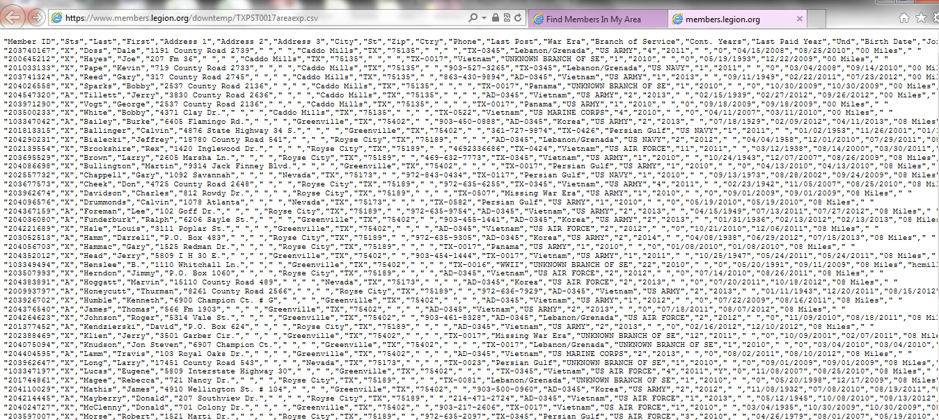
Data which did not “auto” sort.
Here is a sample of the data that did not auto sort and populate into excel for data management.
DO NOT PANIC!

Slide 10
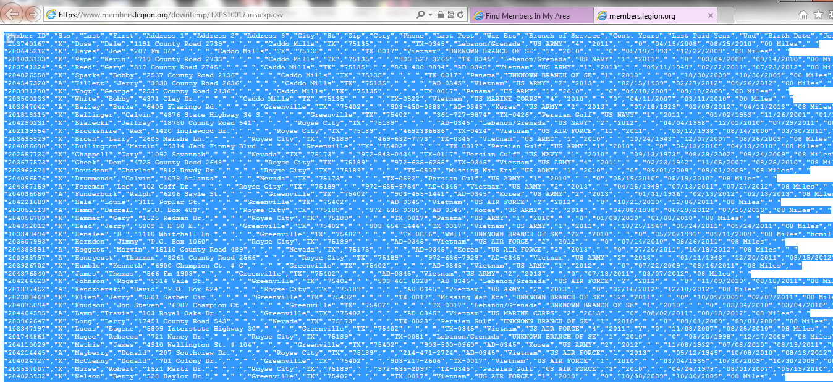
Selecting and Copying the data.
NOTE – If you did not previously have excel open and running, do it now.
The data should have opened up in a different browser window.
Click your mouse anywhere within the jumbled up data.
On your keyboard do the following key strokes:
Hold “ctrl” button down and then type the “a” key.
Hold the “ctrl” button down and then type the “c” key.

Slide 11
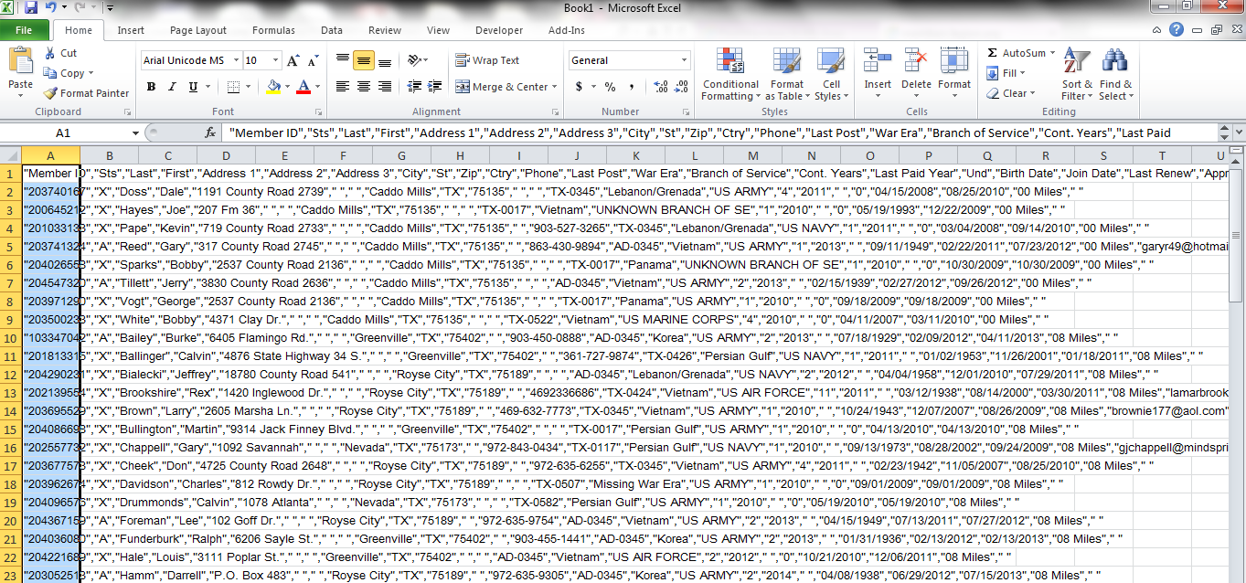
Pasting the CSV data into Excel
With excel open and a “new blank workbook” open:
Place your cursor in cell A1. That is the most upper left top cell in the workbook.
On your keyboard do the following key strokes:
Hold “ctrl” button down and then type the “v” key.
You have now pasted the data into a new workbook.
Highlight column A, so the entire column is selected.

Slide 12
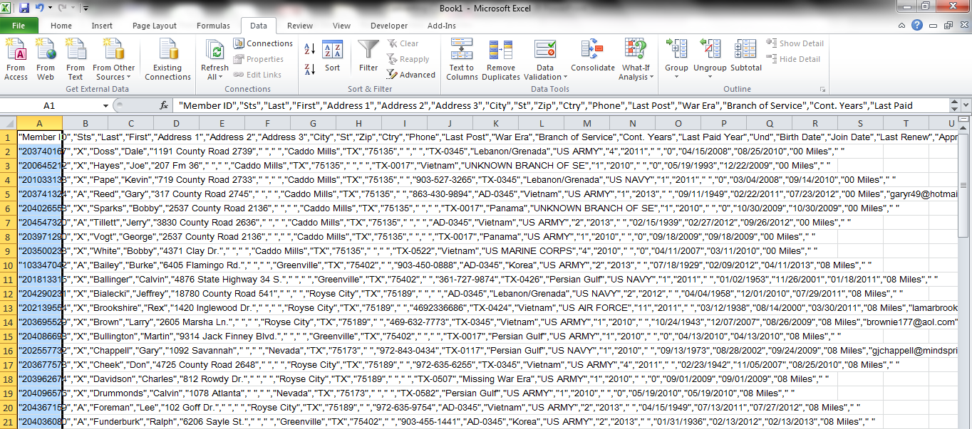
Locating “Data” tab function area of excel
On the excel header bars, you will need to open the “Data” section.

Slide 13
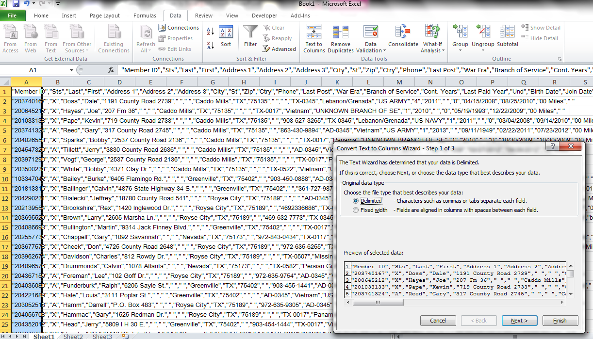
“Text to Columns” Step 1 of 3
Left mouse click the “Text to Columns.” It will bring up a pop up window; Step 1 of 3, within the workbook.
If the “Delimited” radial circle is not highlighted by default, highlight it and click “Next.”

Slide 14
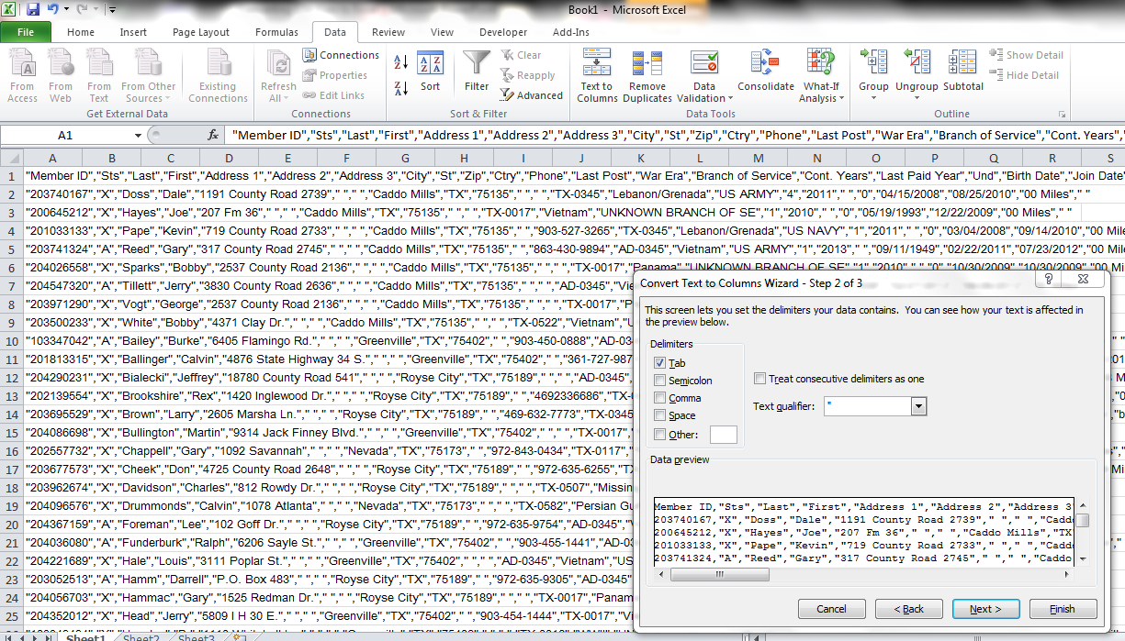
“Text to Columns” Step 2 of 3
A new pop up window will appear; Step 2 of 3, within the workbook.
The Tab box will probably be checked by default.
Place your mouse cursor over it and uncheck it.
The go to the Comma box, Place your mouse cursor over it and left click to check the comma box. Then click “Next.”

Slide 15
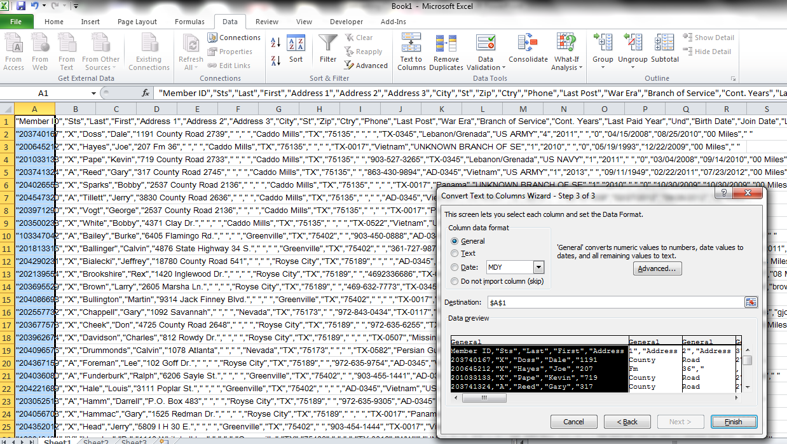
“Text to Columns” Step 3 of 3
A new pop up window will appear; Step 3 of 3, within the workbook.
Click “Finish.”

Slide 16
Data split into individual columns.
Your data is now split into columns within excel.
You can adjust your column widths in order to see your data .
You can add filters to sort and manipulate your data as your needs dictate.

